Slide 1
Project Charter
Team Argus

Slide 2
Overview
General Organization
Scope Statement & Management Plan
Cost Management Plan
Earned Value Management
Work Breakdown Structure
Quality Management Plan
Communication Plan
Change Management Plan
Risk Management Plan
Procurement Management Plan
Project Closeout Report

Slide 3
General Organization
Project Manager
Seth Skocelas
Internal Controls
Meetings
Document Storage
MS Project Plan
External Controls
Individual Status Reports
Team Status Reports
Gate Reviews

Slide 4
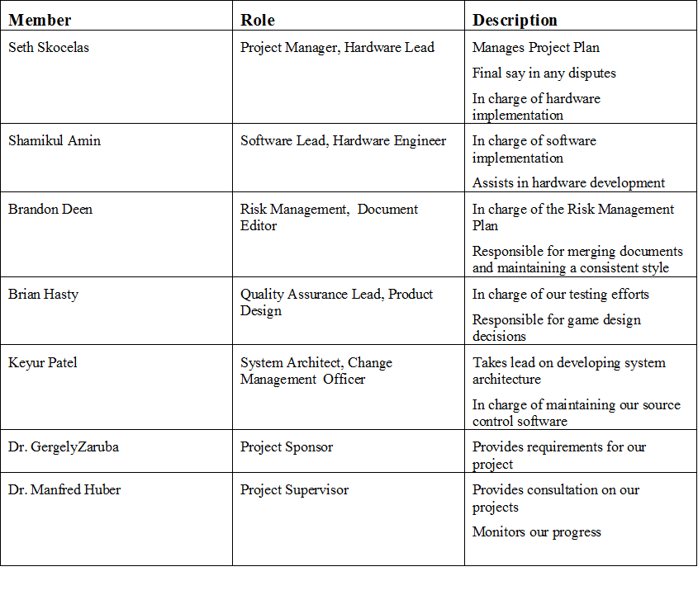
General Organization

Slide 5
General Organization
Project Constraints
Budget
Technical Knowledge
Time
Project Assumptions
Team Commitment
Member Retention
Team Meetings

Slide 6
Scope Statement
Overview: Develop a standard in which two optically capable devices can use to communicate secure information
Boundaries:
Specific Hardware (PixelSense Table, Lynx)
1 Demoable Program (Casino Environment/Game)

Slide 7
Scope Management
Complexity of project components dictate strict control of scope and possible feature creep
Division of Project in order to curb attempts of change
Software | Hardware
 | Build Lynx
Build App to communicate through serial port | Get information from tablet
Develop area on PixelSense to send data | Send Information from Lynx
Develop area on Pixel Sense to receive data | Receive Information from PixelSense on Lynx
Build Blackjack Program | Handle Chip Transactions
Build Roulette*

Slide 8
Scope Management
Changes must conform to priority and scope of current section
Changes require group consensus. Team Lead has the final say
Software | Hardware
 | Build Lynx
Build App to communicate through serial port | Get information from tablet
Develop area on PixelSense to send data | Send Information from Lynx
Develop area on Pixel Sense to receive data | Receive Information from PixelSense on Lynx
Build Blackjack Program | Handle Chip Transactions
Build Roulette*

Slide 9
Cost Management
This cost management plan will make sure that we are within the allotted budget of $800.
Minimize costs as much as possible

Slide 10
Cost Management
Budgeted Work Hours
9 Months
20 Hours per week per person
5 Person Team
Total = 720 Hours

Slide 11
Cost Management
Main hardware needs are a tablet and a custom built arduino.
Extra parts were added for replacement broken parts as well as multiple iterations
Acer A500 Tablet | $69.95
Custom Arduino Device x5 | $128.56
Total | $198.51

Slide 12
Earned Value Management
Three Main Components:
Budgeted Cost of Work Scheduled (BCWS) = Planned Cost (PC)
Actual Cost of Work Performed(ACWP) = Actual Cost (AC)
Budgeted Cost of Work Performed (BCWP) = Earned Value (EV)

Slide 13
Earned Value Management
Cost Performance Index (CPI)
Used to measure the team’s efficiency in completing tasks
If CPI ≥ 1.0, the work is fitting within the budgeted time, which is good.
If CPI < 1.0, we can assume the work is taking longer than planned, which is bad.

Slide 14
Earned Value Management
Schedule Performance Index (SPI)
Tracks how well we are meeting task deadlines
If SPI ≥ 1.0, we can assume we are ahead of schedule.
If SPI < 1.0, we can assume we are behind schedule.

Slide 15
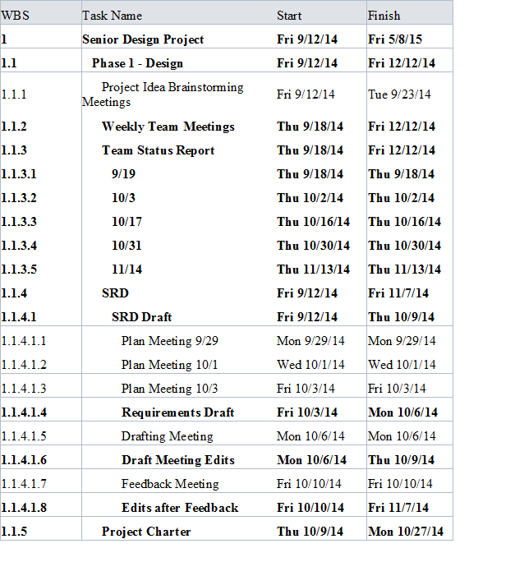
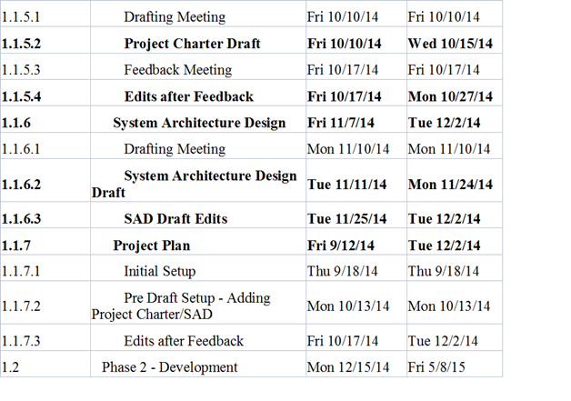
Work Breakdown Structure

Slide 16
Quality Management
Modularity
Hardware and Software components divided into the smallest feasible modules possible
Independent testing cases for each module
Priority chains identified for testing schedule

Slide 17
Quality Management
Document Oriented Testing
Test designed around comments and supplied documentation only
QA Lead can deny a module based on poor documentation
To ensure easy integration and compiling a complete SDK for requirements

Slide 18
Quality Management
Integration
Integration between modules will conform to module testing standards
Modules applied to “core” modules one-by-one
Multiple cores may be necessary for speed, will make final integration more difficult

Slide 19
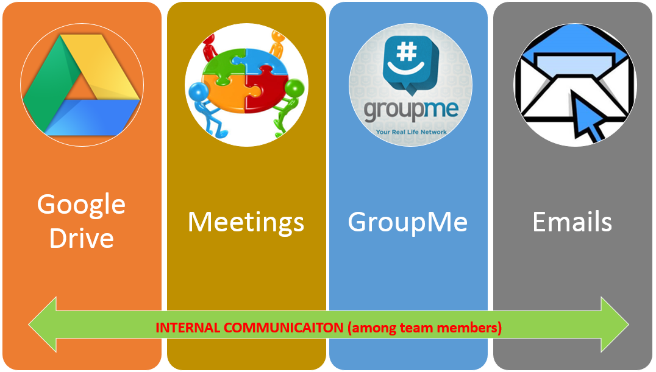
Communication Plan (Internal)

Slide 20
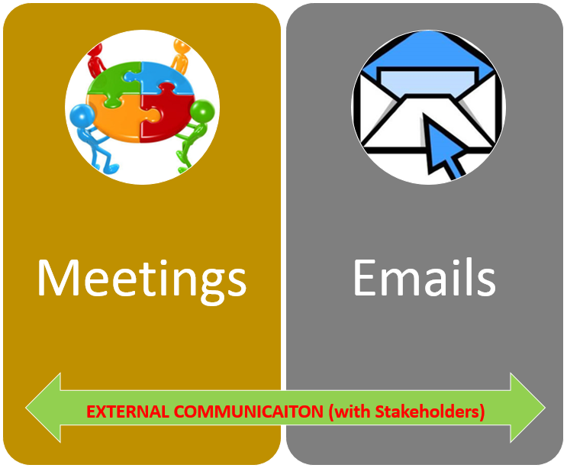
Communication Plan (External)

Slide 21
Change Management Plan
Roles & Responsibilities
Review & Approval Process
Change Identification & Documentation
Change Request form

Slide 22
Change Management Plan
Roles & Responsibilities
Project Sponsor
Responsible to submit change request to project manager.
Project Manager
Discuss with team and finalize.
Project Team
Encouraged to give their input and submit new new requests.

Slide 23
Change Management Plan
Review & Approval Process
Submitting a Change Request
Stakeholders or members can email or submit the change request form with appropriate change details.
Review Process
Project Manager is notified via email by google forms.
Calls for a meeting. Members in meeting discuss the priority and effect on project.
Final decision from the meeting is informed back to stakeholders.
Approval
Once, the sponsor approves the decision, it is documented in future iterations.

Slide 24
Change Management Plan
Change Identification
To identify a change request, this fields in the form must be filled:
Name of the person requesting a Change*
Change Request Description*
Importance of Change*
Project Areas to be Affected*
Change Priority*
Other comments if necessary

Slide 25
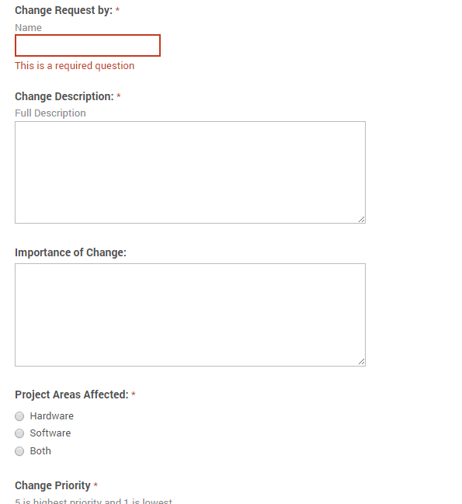

Slide 26
Risk Management Responsibilities
Project Sponsor | •Will be kept up to date with project •Primary source to consult if risks are triggered
Project Manager | •Ensures team stays on track •Ensures the correct action is taken in the case of a risk occurrence
Project Team | •Identifying potential risks •Identify plans to mitigate risks •Follow proper actions if risk occurs
Risk Manager | •Tracking risks •Identifying new risks •Lead team in identifying new risks and mitigation plans

Slide 27
Risk Triggers
Lack of Experience:
C#, Surface SDK, game development
Falling behind schedule
Change in requirements
Loss of teammate (illness, vacation, etc.)
Delay in shipment of hardware

Slide 28
Risk Severity
Risk | Probability | Time Lost (weeks) | Assessment
Change in Requirements | 25% | 2 | 1.25
Lack of game development experience | 75% | 3 | 2.25
Equipment arrival delays | 25% | 2 | .5
Falling behind on schedule | 35% | 3 | 1.05
Overestimating team abilities / Over optimistic planning | 20% | 2 | .4
Loss of team member | 10% | 2 | .2
Integration Issues | 50% | 4 | 2

Slide 29
Risk Containment
Risk | Priority | Containment Strategy | Triggers
Change in Requirements | 2 | Immediately begin to update current plan to reflect new requirements. | Project sponsor changes requirements before they are finalized.
Lack of game development experience for PixelSense using c# | 2 | Remove number of casino games available to play or decrease graphic capabilities of game. | Development of PixelSense game application is taking longer than planned.
Equipment arrival delays | 3 | Work on other areas of the project while waiting on hardware. | Equipment arrival time is delayed.

Slide 30
Risk Containment cont.
Risk | Priority | Containment Strategy | Triggers
Loss of team member | 4 | Re-allocate workload among remaining team members. | Team member is not able to complete their tasks or contribute anything meaningful for anytime longer than 1 week.
Integration Issues | 1 | Research alternative hardware options and utilize them instead. | Unable to integrate Lynx device with the PixelSense table.
Falling behind on schedule | 3 | Remove low priority requirements. | Tasks are not being completed by scheduled timeframe.

Slide 31
Risk Response and Control
Risk Response Planning
Spend additional time on high priority risks
Documentation and Reporting
White board
Risk document on Google drive
Risk Control
Make continuous effort to identify possible risks
Newly identified risks discussed and documented

Slide 32
Procurement Plan
Rules and guidelines for purchasing hardware.
Decisions must be made through the appropriate process

Slide 33
Procurement Plan
Project Sponsor
Dr. Zaruba; responsible for requirements and advice
Project Manager
Seth Skocelas; review parts for ordering and submit to project supervisor

Slide 34
Procurement Plan
Project Team
The project team is responsible of compiling a list of all the components and submit it to the manager
Project Supervisor
Dr. Huber; Approve final parts list and order the part.

Slide 35
Project Closeout Plan
Provides closure on the project
Meet requirements
Archive artifacts
System Requirements Specification
Project Charter
Purchase Requests
Architecture Design Specification
Detailed Design Document
MS Project Plan
Status Reports
System Test Plan
Financial Record
User Manual

Slide 36
Project Closeout Plan
Provides closure on the project
Post Implementation
Customer Acceptance
Financial Records
Final Project Performance

